Slide 1
ERD PROJECT
Group No:19
Group Members
Amina Shehzadi(106411)
Khadija(110811)
Project Title
Food Delivery System with Complaints and Partner Insights Course:
“DATABASE”
Instructor: Prof. Sehrish Khan
Dated: AUG 17, 2025

Slide 2
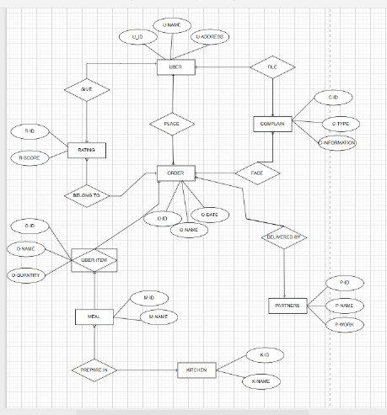
ERD PROJECT

Slide 3
ERD Table
Entities:
User:
(U-ID,U-Name,U-Address)
Order:
(O-ID,O-Date,)
Rating:
(R-ID,R-Score)
Complain:
(C-id,C-type,C-info)
Meal:
(M-id,M-name,M-quantity)

Slide 4
Partners:
(P-ID,P-name,P-Work)
Kitchen:
(K-ID,K-Name)
Relationships:
User places Order
User gives Rating
Order has Rating
User files Complain
Order faces Complain
Order includes Meal
Order delivered by Partners
Meal is prepared by Kitchen

Slide 5
Normalized Relational Schema:
User ( UserID , Name, Address)
Order ( OrderID , Date, UserID)
Rating ( RatingID , Score, UserID, OrderID)
Complain ( ComplainID , Type, Info, UserID, OrderID)
Meal ( MealID , Name)
Item ( ItemID , Name)
Order_Item ( OrderID , ItemID, Quantity)
Partners ( PartnerID , Name, Work)
Kitchen ( KitchenID , Name)

